Slide 1

Java Basics

Slide 2
Today’s Agenda
Java Basics
Data Types
Arrays
Operators
Methods
String
Lab

Slide 3
Review
1. Differentiate b/w Compiler & Interpreter
2. What is the main feature of Java
3. Fill in the blanks
test.CPP (Source File) ==> Compiler ==> (?)
firstApp.java ==> Compiler ==> (?)
4 JVM Stands for (--------)
JRE stands for (--------)
JDK stands for (--------)
5. Java was developed by (?) and in Year (?)
6. Low Level and High Level Languages (Define)

Slide 4
Data Types
A variable in Java must be a specified with data type
Data types are divided into two groups
-Primitive Data types
- Non Primitive Data types

Slide 5
Primitive Data Types
Specifies the size and type of variable values, and it has no additional methods.
There are eight primitive data types in Java:
Data Type | Size | Description
byte | 1 byte | Stores whole numbers from -128 to 127
short | 2 bytes | Stores whole numbers from -32,768 to 32,767
int | 4 bytes | Stores whole numbers from -2,147,483,648 to 2,147,483,647
long | 8 bytes | Stores whole numbers from -9,223,372,036,854,775,808 to 9,223,372,036,854,775,807
float | 4 bytes | Stores fractional numbers. Sufficient for storing 6 to 7 decimal digits
double | 8 bytes | Stores fractional numbers. Sufficient for storing 15 decimal digits
boolean | 2 bytes | Stores true or false values
char | 2 bytes | Stores a single character/letter or ASCII values

Slide 6
Operators in Java
Operator is a symbol that is used to perform operations. For example: +, -, *, / etc.
There are many types of operators in Java which are given below:
Unary Operator,
Arithmetic Operator,
Shift Operator,
Relational Operator,
Bitwise Operator,
Logical Operator,
Ternary Operator and
Assignment Operator.

Slide 7
Java Unary Operator
The Java unary operators require only one operand. Unary operators are used to perform various operations i.e.:
Incrementing/Decrementing a value by one
Negating an expression
Inverting the value of a Boolean

Slide 8
Java Unary Operator
Example:
public class OperatorExample{
public static void main(String args[]){
int x=10;
System.out.println(x++);//10 (11)
System.out.println(++x);//12
System.out.println(x--);//12 (11)
System.out.println(--x);//10
}}

Slide 9
Java Arithmetic Operators
Java arithmetic operators are used to perform addition, subtraction, multiplication, and division. They act as basic mathematical operations

Slide 10
Java Arithmetic Operators
public class OperatorExample{
public static void main(String args[]){
int a=10;
int b=5;
System.out.println(a+b);//15
System.out.println(a-b);//5
System.out.println(a*b);//50
System.out.println(a/b);//2
System.out.println(a%b);//0
}}

Slide 11
Expression
Java Arithmetic Operator Example: Expression
public class OperatorExample{
public static void main(String args[])
{
System.out.println(10*10/5+3-1*4/2);
}
}

Slide 12
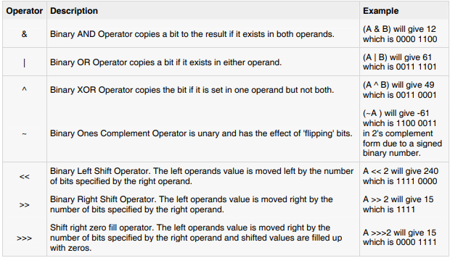
Bitwise operator

Slide 13
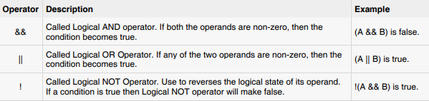
THE LOGICAL OPERATORS

Slide 14
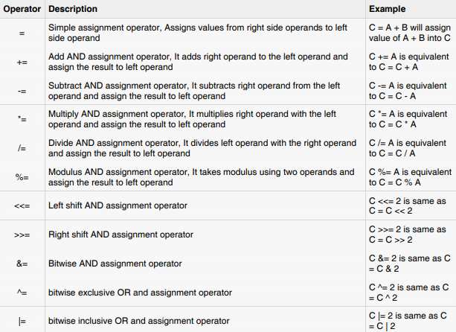
ASSIGNMENT OPERATORS

Slide 15
Java Operator Precedence
Operator Type | Category | Precedence
Unary | postfix | expr++ expr--
 | prefix | ++expr --expr +expr -expr ~ !
Arithmetic | multiplicative | * / %
 | additive | + -
Shift | shift | << >> >>>
Relational | comparison | < > <= >= instanceof
 | equality | == !=
Bitwise | bitwise AND | &
 | bitwise exclusive OR | ^
 | bitwise inclusive OR | |
Logical | logical AND | &&
 | logical OR | ||
Ternary | ternary | ? :
Assignment | assignment | = += -= *= /= %= &= ^= |= <<= >>= >>>=

Slide 16
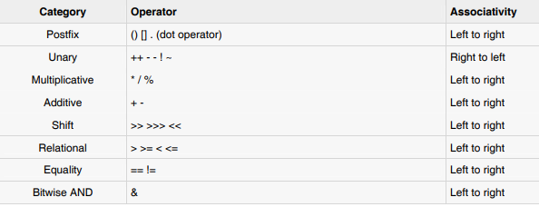
PRECEDENCE OF JAVA

Slide 17
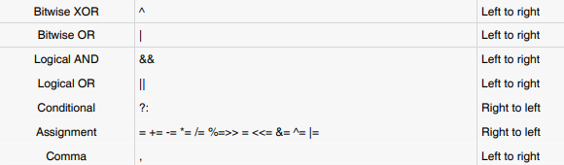
PRECEDENCE OF JAVA

Slide 18
Arrays
An array is a collection of similar types of data
For example, if we want to store the names of 100 people then we can create an array of the string type that can store 100 names.
String[] array = new String[100];
Here, the above array cannot store more than 100 names. The number of values in a Java array is always fixed.

Slide 19
Arrays Declaration
In Java, here is how we can declare an array.
Data type[] Array Name;
Example:
Double[] data;

Slide 20
Defining Arrays Size
To define the number of elements that an array can hold, we have to allocate memory for the array in Java.
For example,
Double[] data;
Data= new double[10];
In Java, we can declare and allocate the memory of an array in one single statement. For example,
double[] data= new double[10];

Slide 21
Initialize Arrays in Java
In Java, we can initialize arrays during declaration. For example,
//declare and initialize and array Single Line Syntax
int[] age = {12, 4, 5, 2, 5};
// declare an array – Two Line Syntax
int[] age = new int[5];
// initialize array
age[0] = 12;
age[1] = 4;
age[2] = 5;

Slide 22
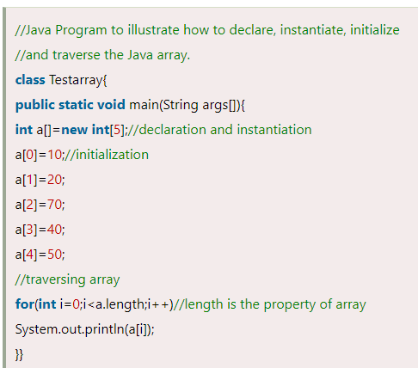
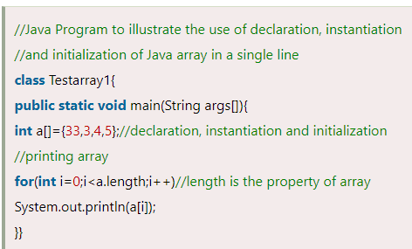
Arrays

Slide 23
Example
class Main {
public static void main(String[] args) {
// create an array
int[] age = {12, 4, 5, 2, 5};
// access each array elements
System.out.println("Accessing Elements of Array:");
System.out.println("First Element: " + age[0]);
System.out.println("Second Element: " + age[1]);
System.out.println("Third Element: " + age[2]);
System.out.println("Fourth Element: " + age[3]);
System.out.println("Fifth Element: " + age[4]);
}

Slide 24
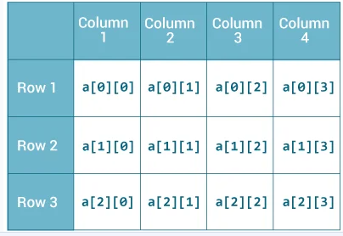
2D array in Java
int[][] a = new int[3][4];

Slide 25
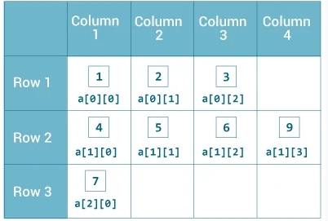
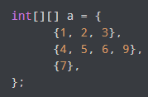
2D array in Java
As we can see, each element of the multidimensional array is an array itself. And also, unlike C/C++, each row of the multidimensional array in Java can be of different lengths.

Slide 26
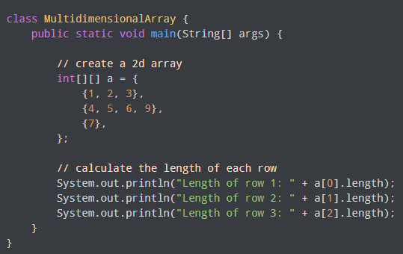
2D array in Java

Slide 27
Looping through array
class Main {
public static void main(String[] args) {
// create an array
int[] age = {12, 4, 5};
// loop through the array
// using for loop
System.out.println("Using for Loop:");
for(int i = 0; i < age.length; i++)
{
System.out.println(age[i]);
}
}
}

Slide 28
Sum and avg of elements
class Main {
public static void main(String[] args) {
int[] numbers = {2, -9, 0, 5, 12, -25, 22, 9, 8, 12};
int sum = 0;
Double average;
// access all elements using for each loop
// add each element in sum
for (int number: numbers) {
sum += number;
}
// get the total number of elements
int arrayLength = numbers.length;
// calculate the average
// convert the average from int to double
average = ((double)sum / (double)arrayLength);
System.out.println("Sum = " + sum);
System.out.println("Average = " + average);
}
}

Slide 29
Multidimensional Arrays
double[][] matrix = {{1.2, 4.3, 4.0}, {4.1, -1.1}};

Slide 30
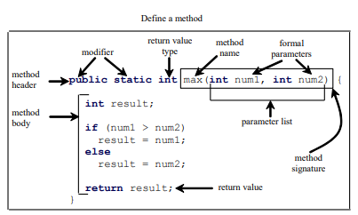
Methods in java
A Java method is similar to function in C/C++. It is a collection of statements that are grouped together to perform an operation. When you call the System.out.println method, for example, the system actually executes several statements

Slide 31
Methods
A method definition consists of a method header and a method body. Here are all the parts of a method:
Modifiers: The modifier, which is optional, tells the compiler how to call the method. This defines the access type of the method.
Return Type: A method may return a value. The returnValueType is the data type of the value the method
returns. Some methods perform the desired operations without returning a value. In this case, the returnValueType is the keyword void.
Method Name: This is the actual name of the method. The method name and the parameter list together constitute the method signature.

Slide 32
Methods
Parameters: A parameter is like a placeholder. When a method is invoked, you pass a value to the parameter. This value is referred to as actual parameter or argument. The parameter list refers to the type, order, and number of the parameters of a method. Parameters are optional; that is, a method may contain no parameters.
Method Body: The method body contains a collection of statements that define what the method does.

Slide 33
CALLING A METHOD
public class TestMax {
/** Main method */
public static void main(String[] args) {
int i = 5;
int j = 2;
int k = max(i, j);
System.out.println(“Maximum " + k);
}
/** Return the max between two numbers */
public static int max(int num1, int num2) {
int result;
if (num1 > num2)
result = num1;
else
result = num2;
return result;
}}

Slide 34
THE VOID KEYWORD
public class TestVoidMethod {
public static void main(String[] args) {
printGrade(78.5);
}
public static void printGrade(double score) {
if (score >= 90.0) {
System.out.println('A');
}
else if (score >= 80.0) {
System.out.println('B');
}
else if (score >= 70.0) {
System.out.println('C');
}
else if (score >= 60.0) {
System.out.println('D');
}
else {
System.out.println('F');
}
}
}

Slide 35
THE CONSTRUCTORS
A constructor initializes an object when it is created. It has the same name as its class and is syntactically similar to a method. However, constructors have no explicit return type.
All classes have constructors, whether you define one or not, because Java automatically provides a default constructor that initializes all member variables to zero. However, once you define your own constructor, the default constructor is no longer used.

Slide 36
THE CONSTRUCTORS
// A simple constructor.
class MyClass {
int x;
// Following is the constructor
MyClass() {
x = 10;
}
}

Slide 37
THE CONSTRUCTORS
public class ConsDemo {
public static void main(String args[]) {
MyClass t1 = new MyClass();
MyClass t2 = new MyClass();
System.out.println(t1.x + " " + t2.x);
}
}

Slide 38
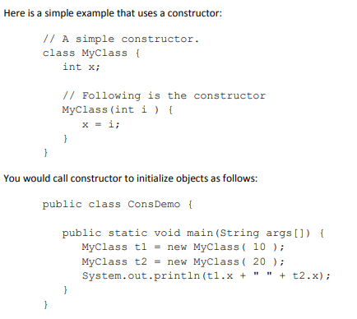
constructor

Slide 39
Strings in java
In java, string is basically an object that represents sequence of char values.
char[] ch={‘e',‘d',‘m','a','t',‘r',‘i',‘x'};
String s=new String(ch); is same as
String s=“edmatrix";

Slide 40
Example
public class StringDemo{
public static void main(String args[]){
char[] helloArray = { 'h', 'e', 'l', 'l', 'o', '.'};
String helloString = new String(helloArray);
System.out.println( helloString );
}
}

Slide 41
String Length:
public class StringDemo {
public static void main(String args[]) {
String palindrome = "Dot saw I was Tod";
int len = palindrome.length();
System.out.println( "String Length is : " + len );
}
}

Slide 42
Concatenating Strings
public class StringDemo {
public static void main(String args[]) {
String string1 = "saw I was ";
System.out.println("Dot " + string1 + "Tod");
}
}
Output: Dot saw I was Tod

Slide 43
String methods
toUpperCase()
toLowerCase()
trim()
startsWith() and endsWith()
charAt(index)
length()
replace()
substring()
tocharArray()

Slide 44
Decision Making & Loops
If Statement
If-else & Nested if-else Statement
Switch Statement
Loops (for, While and do-while

Slide 45
Decision Making & Loops
// Java program to illustrate If statement
class IfDemo {
public static void main(String args[])
{
int i = 10;
if (i > 15)
System.out.println("10 is less than 15");
// This statement will be executed
// as if considers one statement by default
System.out.println("I am Not in if");
}
}

Slide 46
Decision Making & Loops
// Java program to illustrate if-else statement
class IfElseDemo {
public static void main(String args[])
{
int i = 10;
if (i < 15)
System.out.println("i is smaller than 15");
else
System.out.println("i is greater than 15");
}
}

Slide 47
Decision Making & Loops
// Java program to illustrate nested-if statement
class NestedIfDemo {
public static void main(String args[])
{
int i = 10;
if (i == 10 || i<15) {
// First if statement
if (i < 15)
System.out.println("i is smaller than 15");
// Nested - if statement
// Will only be executed if statement above
// it is true
if (i < 12)
System.out.println(
"i is smaller than 12 too");
} else{
System.out.println("i is greater than 15");
}
}
}

Slide 48
Decision Making & Loops
// Java program to illustrate if-else-if ladder class ifelseifDemo { public static void main(String args[]) { int i = 20; if (i == 10) System.out.println("i is 10"); else if (i == 15) System.out.println("i is 15"); else if (i == 20) System.out.println("i is 20"); else System.out.println("i is not present"); } }

Slide 49
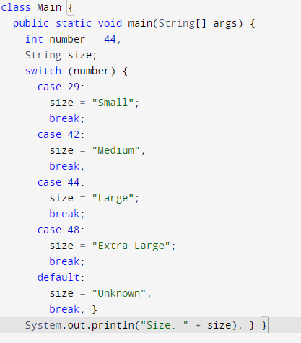
Decision Making & Loops

Slide 50
Decision Making & Loops
// Java program to illustrate using // continue in an if statement class ContinueDemo { public static void main(String args[]) { for (int i = 0; i < 10; i++) { // If the number is even // skip and continue if (i % 2 == 0) continue; // If number is odd, print it System.out.print(i + " "); } } }

Slide 51
Decision Making & Loops
// Java program to illustrate using return class Return { public static void main(String args[]) { boolean t = true; System.out.println("Before the return."); if (t) return; // Compiler will bypass every statement // after return System.out.println("This won't execute."); } }

Slide 52
Decision Making & Loops
//Java Program to demonstrate the example of for loop //which prints table of 1 public class ForExample { public static void main(String[] args) { //Code of Java for loop for(int i=1;i<=10;i++){ System.out.println(i); } } }

Slide 53
Decision Making & Loops
public class NestedForExample { public static void main(String[] args) { //loop of i for(int i=1;i<=3;i++){ //loop of j for(int j=1;j<=3;j++){ System.out.println(i+" "+j); }//end of i }//end of j } }

Slide 54
Decision Making & Loops
Java for-each Loop The for-each loop is used to traverse array or collection in Java. It is easier to use than simple for loop because we don't need to increment value and use subscript notation. It works on the basis of elements and not the index. It returns element one by one in the defined variable.
//Java For-each loop example which prints the //elements of the array public class ForEachExample { public static void main(String[] args) { //Declaring an array int arr[]={12,23,44,56,78}; //Printing array using for-each loop for(int i:arr){ System.out.println(i); } } }

Slide 55
Decision Making & Loops
//Java program to demonstrate the use of infinite for loop //which prints an statement public class ForExample { public static void main(String[] args) { //Using no condition in for loop for(;;){ System.out.println("infinitive loop"); } } }

Slide 56
Decision Making & Loops
public class WhileExample { public static void main(String[] args) { int i=1; while(i<=10){ System.out.println(i); i++; } } }
public class DoWhileExample { public static void main(String[] args) { int i=1; do{ System.out.println(i); i++; }while(i<=10); } }

Slide 57
Any Question
THANK YOU ☺

